Slide 1
Game Idea Presentation
By Joseph Roper

Slide 2
Brief Intro:
My game title will be called “Boy”.
In the game you play as a child who was separated from his parents as you are left in a shanty town to survive on your own. The child soon becomes wanted for stealing food from market stalls making you wanted by the guards as you climb and crawl through the map being chased while you try to find your parents.
The target audience for the game will be 12+

Slide 3
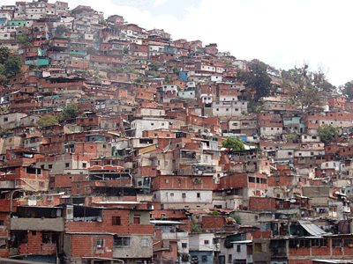
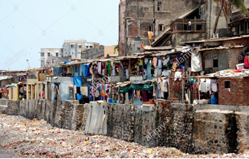
Terrain/ Architecture:
The game will be held in a shanty town meaning the terrain will be sand, dirt and old scrap buildings which the player will have to go across. The buildings will be made out of scrap metal, bricks, wood and plastic and will break easily if the player stays on them for too long or jumps on them several times. There will be occasional be rusty metal pipes that the player can damage themselves on.

Slide 4

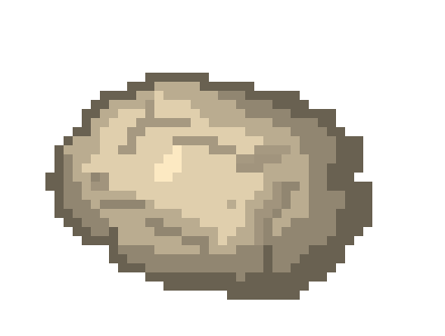

Objects:
Usable objects I will have in my game are rocks and sticks that the player will be able to pick up and throw at structures to open up new paths in the game for the player to explore.
Other objects will be crates that the player will be able to move to access unreachable areas.

Slide 5
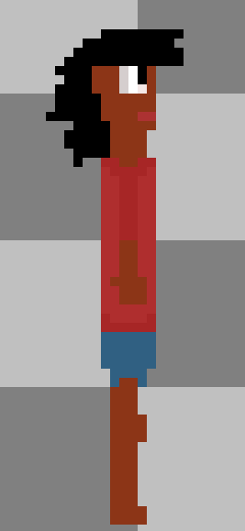


Characters:
Character: Boy
Character Type: Protagonist
Capabilities: Quick, nimble and small
Character: Head Guard
Character Type: Antagonist
Capabilities: Big, strong owns a sword

Slide 6
Gameplay:
The genre of the game will be a puzzle platformer therefore the game will revolve around solving puzzles to unlock the new areas of the game while traversing over the dangerous in-game architecture. A main aspect of the game is also how you would avoid the guards by finding new with your small stature.

Slide 7
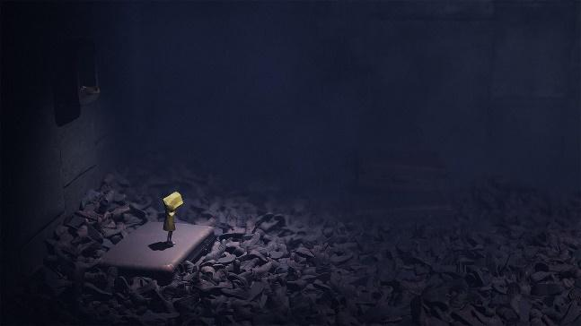
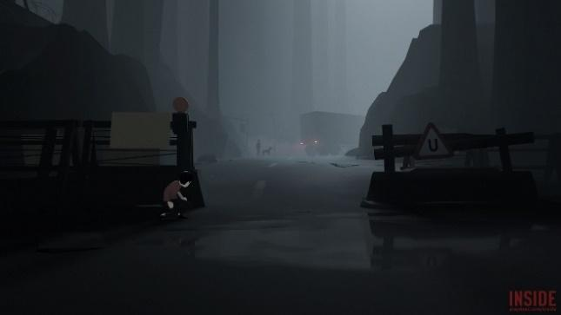

Mood Board:
The game will be like Little Nightmares where the character is so small compared to the rest of the world and you never feel safe.
It will also be like the game Inside where you have to hide from the enemies and make your way past them.
Little Nightmares
Inside

Slide 8
Gameflow Diagram:
Traverse through level
This will be the constant objectives the player will have and will achieve throughout each new portion of the game.
Buy food and equipment
Hide/Escape from guards.
Collect Money through level

Slide 9
Feedback:
The feedback the player will receive for the platformer game will be through sound, touch and sight. With sound, the player will be able to hear when enemies are close giving the player a chance to avoid them. With touch, the controller will vibrate when the player gets hit or falls from a ledge representing damage. And finally, though sight the player will be able to see the players health bar and read dialogue when speaking with NPC’s.

Slide 10
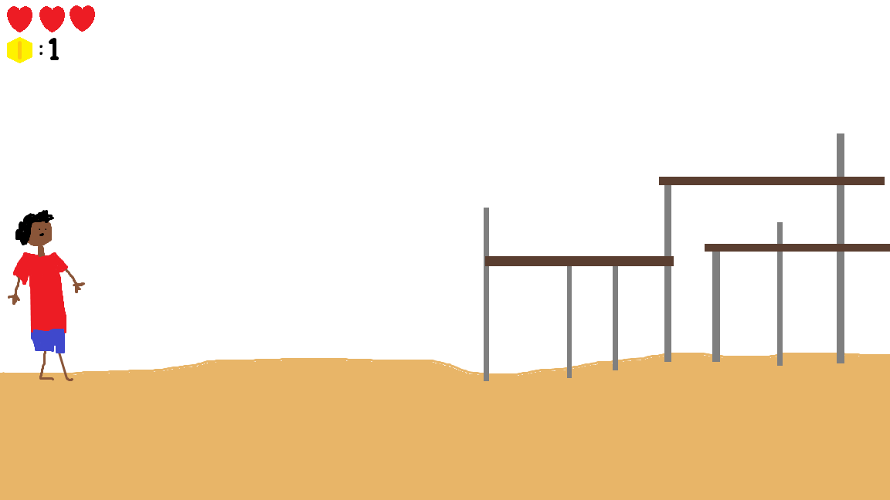
Interface:

Slide 11
Perspective:
The perspective of my game will be a 2D side scrolling puzzle platformer similar to the game Inside. I chose this perspective as it is the easiest and most supported perspective in the game engine I will be using Construct 2.

Slide 12
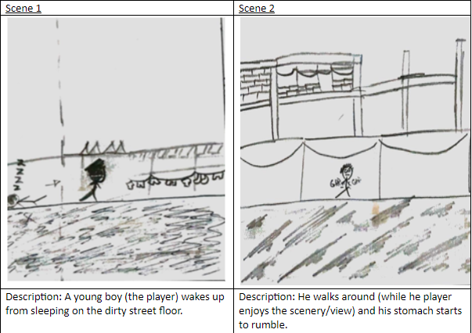
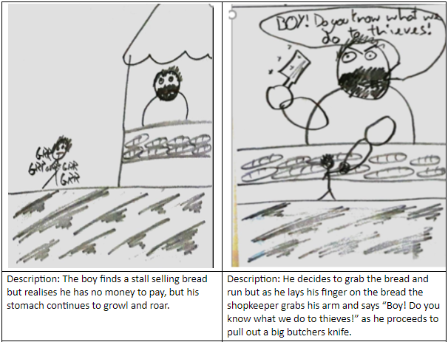
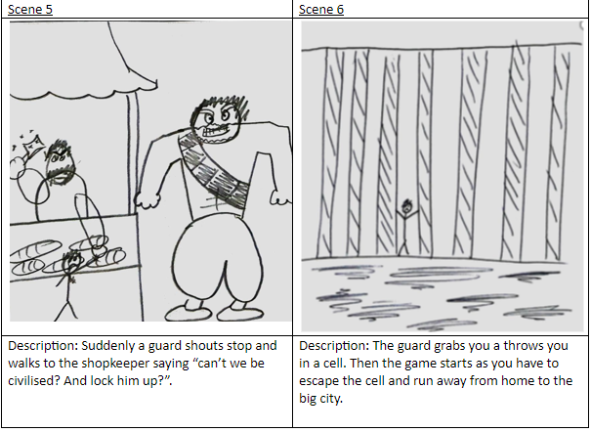
FMV:
My FMV will be based off of my story board as the opening cutscene to introduce the player to the character Boy and the cruel world he lives in.

Slide 13
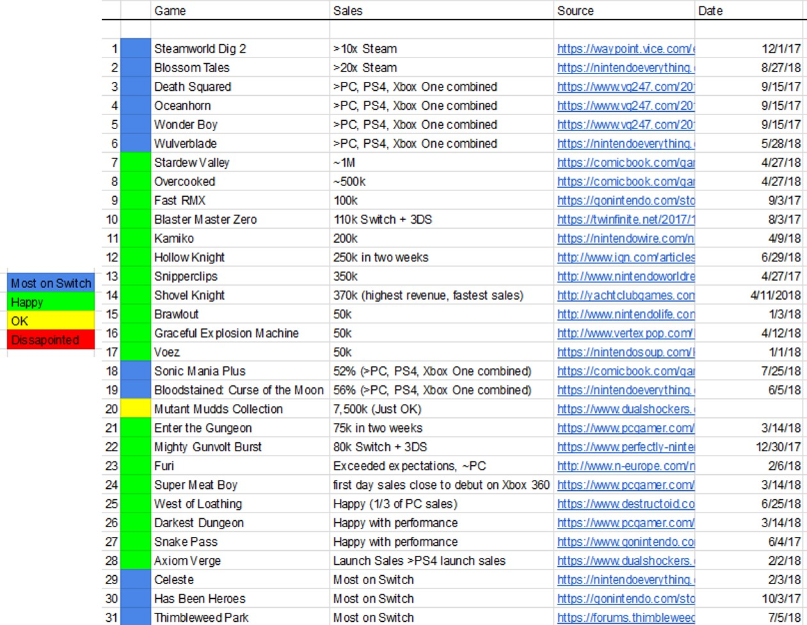
Platform
I would like my game to be on every current gen device to access a wider audience however I believe it will be best suited to handheld gameplay so out of every console I would prefer it to be on the Nintendo Switch more as the indie game market is really taking off and doing well on that device.
https://www.resetera.com/threads/how-are-indie-games-actually-performing-on-switch-sales-reports-so-far.64916/

Slide 14
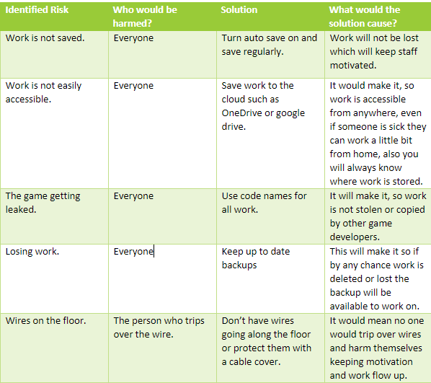
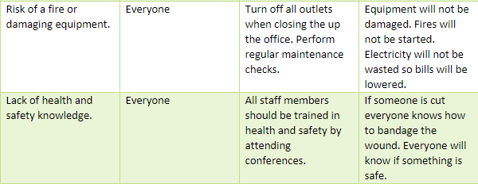
Risk Assessment & S.W.O.T Analysis
S.W.O.T Analysis
What are your businesses strengths? - Determination, charisma, enthusiasm, no publishers changing our idea - no true deadlines.
What are your weaknesses? - First company and my first game, lack of experience - limited budget and resources.
What are your opportunities? - Game jams - gaming conventions, your tubers for promotion.
What are your threats? - lacking experience might not be able to do some things we want to because of time, budget.

